Slide 1


ALPR
What is it and how does it work?
  Automated license plate readers (“ALPRs”) are computer-controlled, high-speed camera systems that automatically capture images of license plates that come into view.

Slide 2
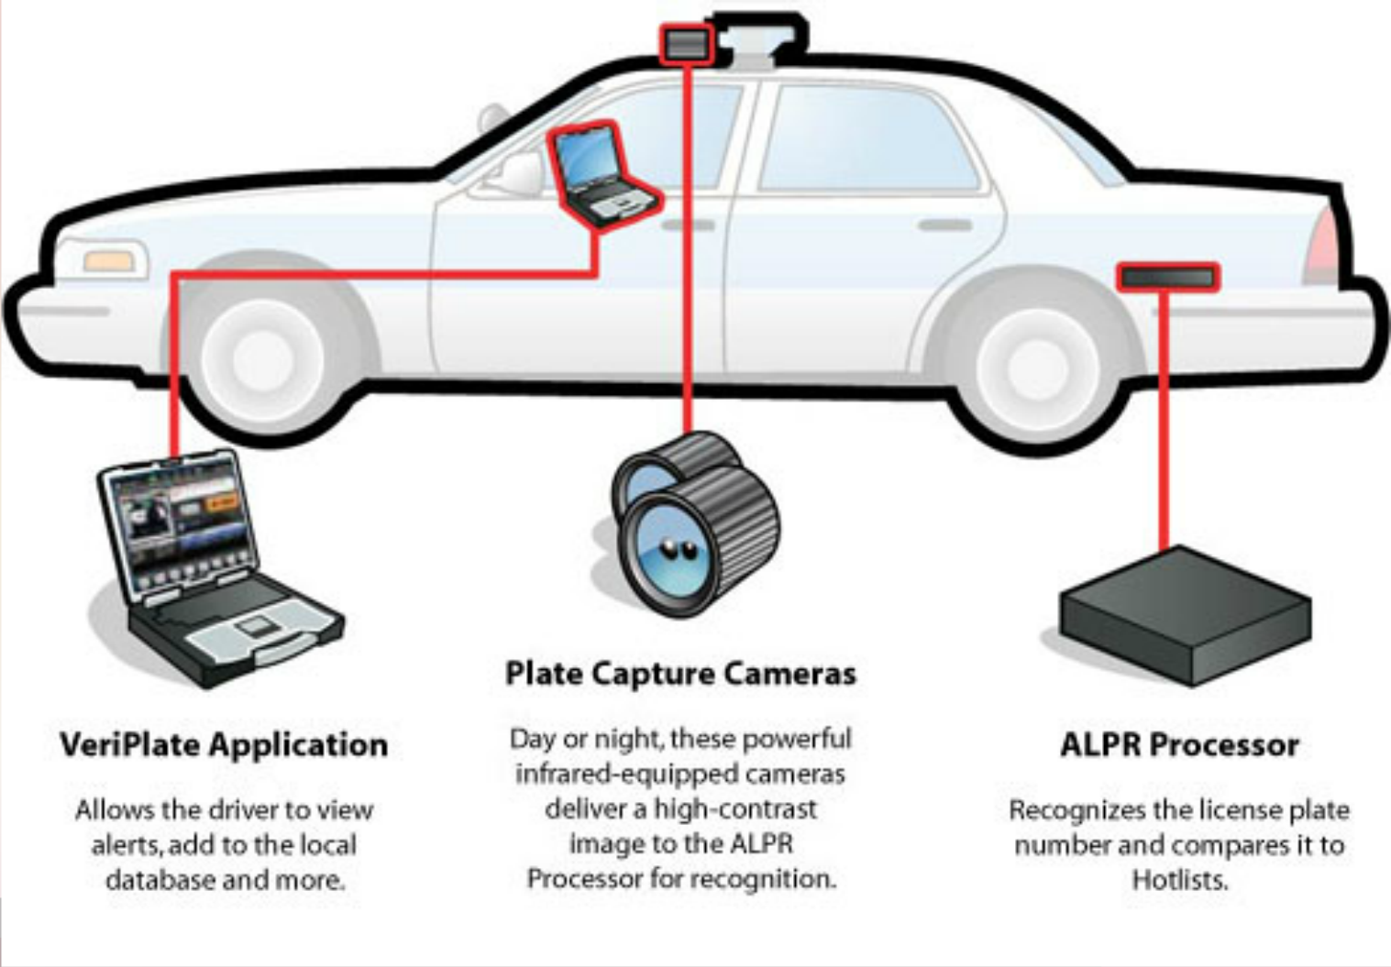
ALPR Components
1
3
2

Slide 3
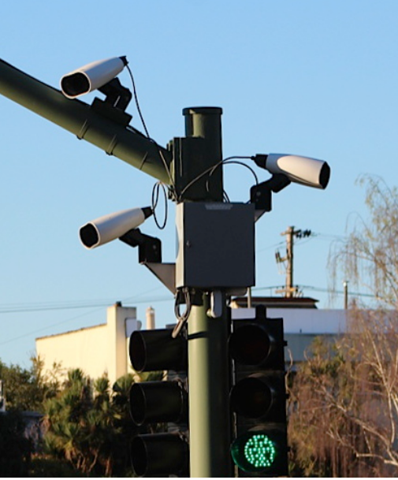
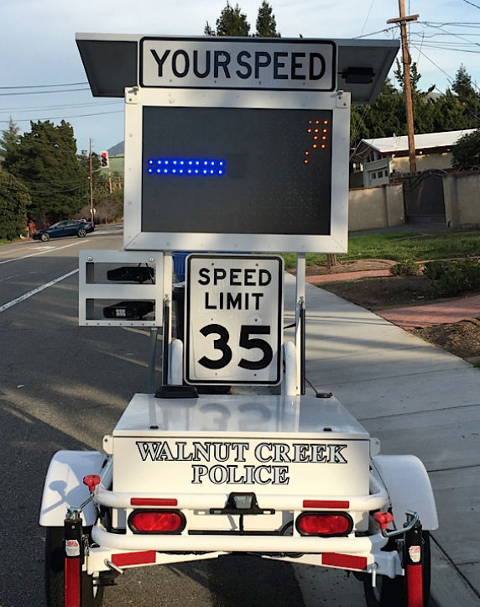
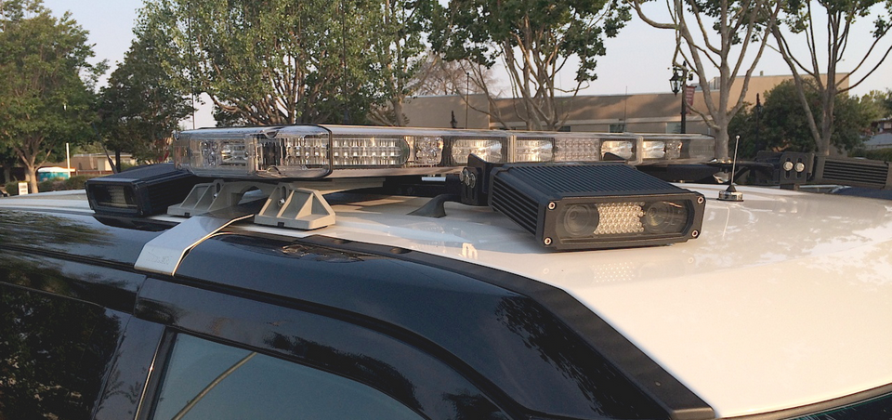
ALPR Cameras
Types of ALPR Cameras:
  Fixed locations - like streetlights
  Semi-stationary vehicles - like truck trailers
  Mobile – usually police vehicles.

Slide 4
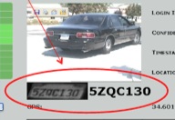
ALPR Processors/Apps
What is it and how does it work?
  After a camera captures an image of a car and its surroundings, the image of the license plate is converted into alphanumeric data

Slide 5
ALPR
What is it and how does it work?
  ALPRs capture the time and place where a license plate was seen for police departments, which then use the data in real time to make traffic stops or store it for future use.
  In many ALPR systems, the license plate data is automatically compared against a “hot list” of vehicles of interest. The ALPR then alerts police, who may stop the car.

Slide 6

ALPR
Privacy Issues
  Stored data may allow police to trace a person’s past movements, determine patterns of behavior, and plot vehicles that were present at a particular location and time.
  Historic data may reveal intimate details:
    Where you work
    Where you live & with whom
    What doctors you see
    Who you associate with

Slide 7
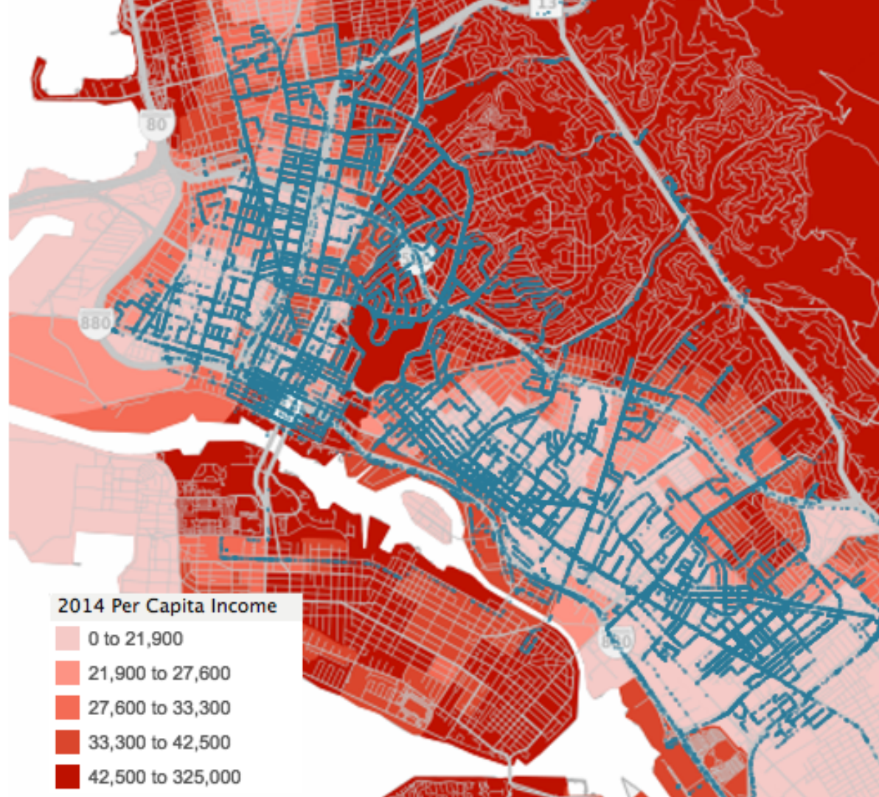
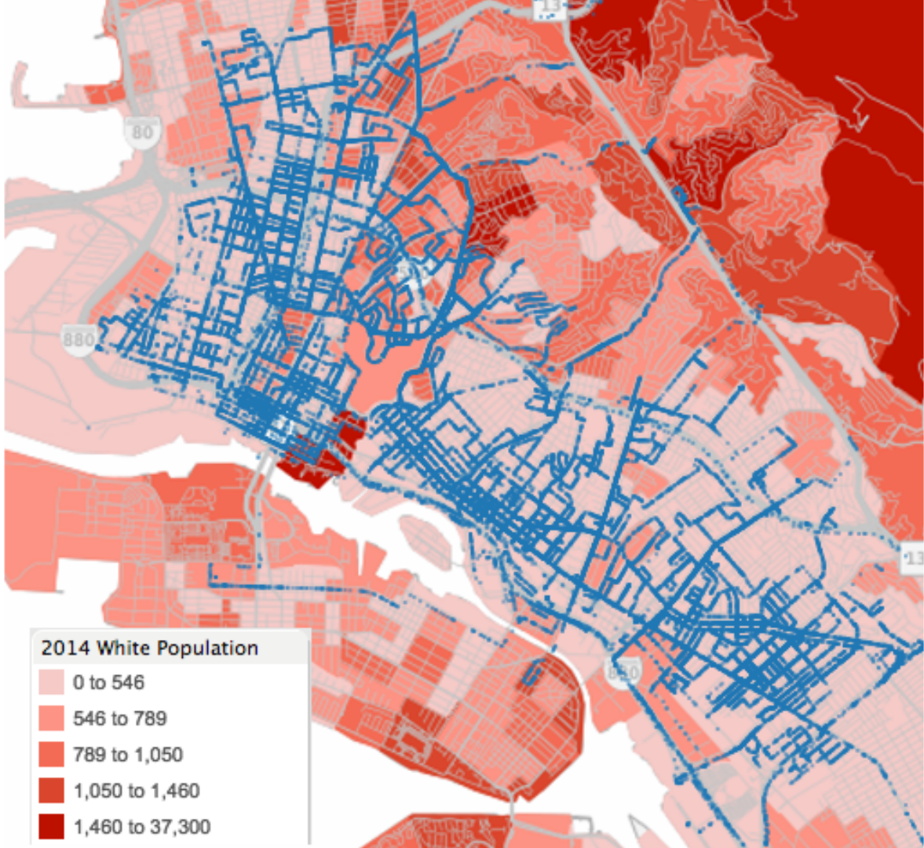
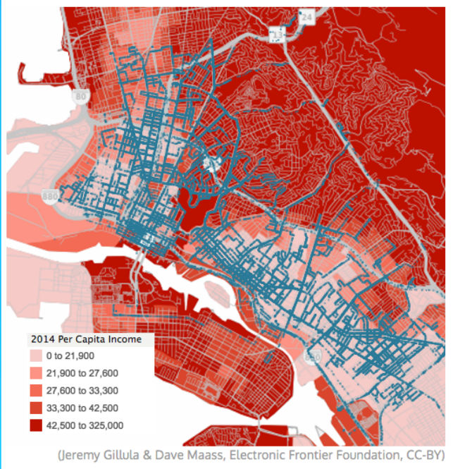
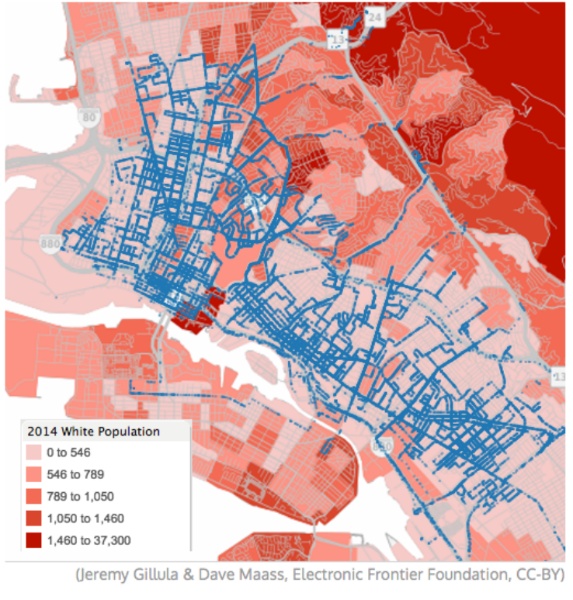
ALPR
Bias Issues
  EFF PRAs to Oakland PD show ALPR mainly deployed in low-income communities of color.

Slide 8
ALPR-related cases:
  6th Circuit: US v Ellison (462 F.3d 557 (2006)): No REP in LP number
  9th Circuit: US v. Diaz-Castaneda (494 F.3d 1146 (2007)): Court noted consensus among the circuits that single-instance ALPR database check ≠ search

Slide 9
ALPR-related cases:
  9th Circuit: Green v. City & Cnty. of San Francisco (751 F.3d 1039 (2014)): Court held that genuine issue of material fact existed as to whether officer had reasonable suspicion to make a stop despite an ALPR hit.
  GA Court of Appeals: Hernandez-Lopez v. State (319 Ga. App. 662 (2013)): Court held that an ALPR hit indicating an outstanding warrant created reasonable suspicion to justify a traffic stop.

Slide 10
ALPR
How do I fight ALPR evidence?
  File an MTS – unverified ALPR hit alone (i.e. software match without visual confirmation) may not justify a stop (Green)
  In some states, ALPR use must meet statutory requirements. Some state laws may provide suppression remedy for statutory violations: https://eff.org/ALPRstatelaws

Slide 11
ALPR
How do I fight ALPR evidence?
  Persistent ALPR use to track a person over a prolonged period of time may implicate 4th Amendment protections and should arguably require a warrant supported by probable cause. Analogize to US v. Jones, 565 US 400 (2012) & Cell Site Location Information cases. (see CSLI one-pager)

Slide 12
ALPR
How do I learn more?
  ALPR basics: https://eff.org/ALPRprimer
  Blog on types of ALPR: https://eff.org/ALPRtypes
  ALPR FAQs: https://eff.org/ALPRFAQ

